Slide 1

University of Sulaimani
College of Science
Computer Science
Memory Puzzle Game – Project Report
Prepared by:
Lawand Rebwar Othman
Mohammed Abubakr Abdulla
Warida Pshtewan
Dene Ayub
Supervised By:
Ramyar Abdulrahman Teimoor Ismael

Slide 2
Contents
Introduction
Game Overview: Match the Fruits
Key Features
Objective and Rules
Game Mechanics
AI Algorithm Used: Rule-Based Logic
Game Flow Description
Programming Language and Tools
Conclusion

Slide 3
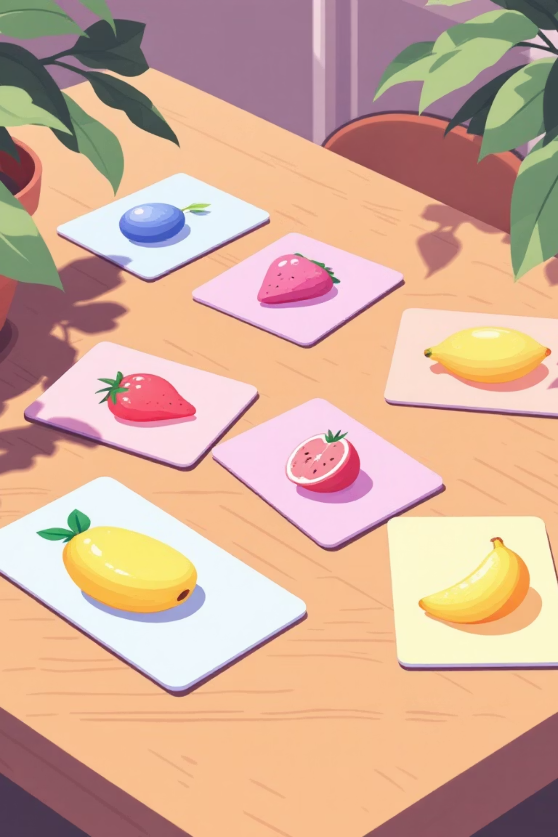
Introduction
The Memory Puzzle Game is a single-player card-matching puzzle developed using Python. It challenges players to match pairs of hidden fruit cards within a time limit, enhancing memory, concentration, and logical thinking skills.
This report details the game's development, core features, AI algorithms, and overall design, demonstrating practical application of programming and algorithmic concepts.

Slide 4
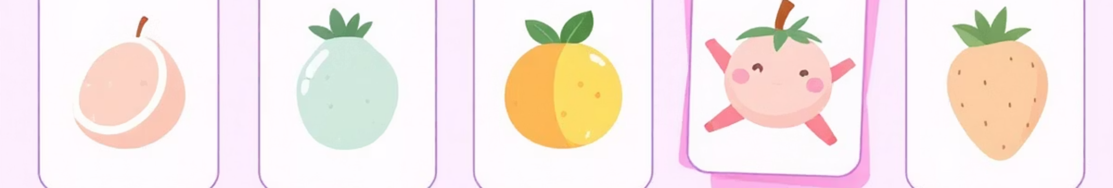
Game Overview: Match the Fruits!
The game presents a grid of face-down cards, each concealing a unique fruit image. Every fruit appears exactly twice. Players' objective is to flip two cards at a time to find matching pairs.
The game features multiple levels, with difficulty progressively increasing by adding more card pairs, ensuring a continuous challenge for players.

Slide 5
Key Features
Multiple Difficulty Levels
Countdown Timer
Hint System
Progressive challenges with increasing card pairs.
Time limits for each level add urgency and excitement.
Assistance for players when they get stuck.
Pause & Resume
Sound & Animations
Flexibility to control gameplay at any moment.
Engaging audio-visual feedback for an immersive experience.

Slide 6

Objective and Rules
Objective
The primary goal is to match all card pairs before the level's timer expires.
Rules
Players can flip two cards per turn.
Matching cards remain face-up.
Non-matching cards automatically flip back down.

Slide 7
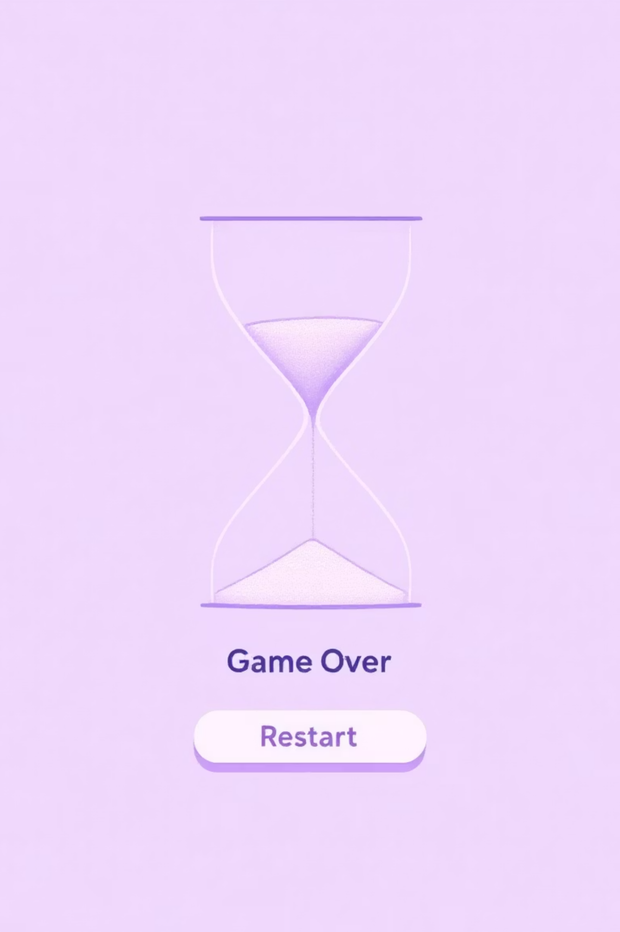
Game Mechanics
1
Match All Pairs
All card pairs must be matched within the given time limit to clear the level.
2
Increasing Difficulty
Each subsequent level introduces more cards, increasing the challenge.
3
Limited Hints
A finite number of hints are available to assist players.
4
Time-Out Penalty
If the timer runs out, the game restarts from level one.

Slide 8

AI Algorithm Used: Rule-Based Logic
The game employs rule-based artificial intelligence logic, not machine learning, to govern game mechanics. This logic dictates card behavior, matching decisions, hint functionality, and level progression.
Algorithm Concepts
Random card shuffling for varied gameplay.
State tracking to monitor card positions and status.
Conditional match checking for pair verification.
Hint detection logic to guide players.
Timer-based control for game progression and limits.

Slide 9
Game Flow Description
1
2
3
Start Game
Initialize Level & Timer
Shuffle Cards
Initiates the game sequence.
Sets up the current level and countdown.
Randomizes card positions.
4
5
6
Match Verification
Display Cards
Player Selects Cards
User interaction to flip two cards.
Checks if selected cards form a pair.
Presents the face-down card grid.
7
8
9
Update Game State
Level Completion/Restart
End Game Summary
Reflects changes like matched cards or timer progress.
Determines next action based on game state.
Displays final score and performance.

Slide 10
Programming Language and Tools
The Memory Puzzle Game is developed entirely in Python, leveraging a suite of powerful libraries and tools to create a robust and interactive experience.
Python
Tkinter
The core programming language for game logic.
Used for building the graphical user interface (GUI).
PIL (Pillow)
Random Module
Handles all image processing and display within the game.
Ensures fair and unpredictable card shuffling.
Time & After()
Winsound
Manages the in-game timer and event scheduling.
Integrates sound effects for an enhanced user experience.

Slide 11

Conclusion
This project effectively demonstrates Python's capabilities in game development, showcasing rule-based AI logic and event-driven programming. It highlights modular design principles, logical thinking, and the practical application of algorithms in an interactive environment.
The Memory Puzzle Game serves as a testament to how fundamental programming concepts can be combined to create engaging and educational software.

Slide 12

Thank You!
We hope you enjoyed this report on the Memory Puzzle Game. For any questions or further details, please feel free to reach out.
This project was a valuable exercise in bringing theoretical concepts to life through practical application.

